Slide 1


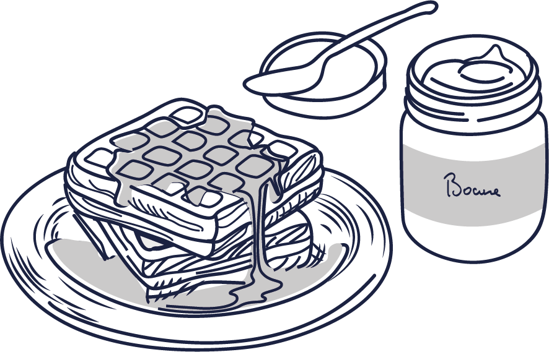
CHEESE
WAFFLES
Curd Cheese
Nature 4.50
Duble cream 4.80
Red berry coulis 4.80
Apple Compote 5.50
& Red berry coulis
Demi-Saint-Marcellin
Affiné «Mère Richard» 5.50
Cervelle de Canut 5.50
Curd cheese, shallot, herbs
Grandma’s Waffles
Toppings :
Whipped cream/ Chocolate/ Compote
Paul Bocuse homemade spread:
Salted butter caramel/ Praline
2 Toppings 9.10
3 Toppings 9.50
Additional garnish 1.00
« Domino » Waffles,
with Paul Bocuse Café 7.80
Find our spreads and other treats on our online store : maisons-bocuse.com
DESSERTS
Rum Baba 10.50
Whipped cream, Havana rum
Vacherin and Fresh Fruits 11.50
Homemade Meringues, ice cream, whipped cream and red berry coulis
Chocolate Fondant 11.00
Custard sauce, whipped cream
Fresh Fruits Salad 10.00
Vanilla Crème Brulée 10.50
Crêpes Suzette, Candied Orange Zest 11.50
Flamed at your table
Fresh Strawberries 11.00
Plain, with Sugar, or with Whipped Cream
Cardinale Strawberry Sundae 12.50
Vanilla Ice Cream, Whipped Cream and Red Berry Coulis
Notre Chef est à votre disposition en cas de restrictions alimentaires ou d’allergies.
Les informations relatives aux allergènes peuvent être consultées sur demande.
Prix nets en euros, taxes et service compris. L’établissement n’accepte plus les règlements par chèque bancaire.

Slide 2

CAFE HOME BRAND ELABORATED IN COLLABORATION WITH A MASTER ARTISAN FRENCH ROASTER
Espresso Café Paul Bocuse Sensation 2.80
100% Arabica, blend of 3 fine arabicas : Brasil, Colombia, Ethiopia
Ristretto Café Paul Bocuse Sensation 2.80
Espresso Café Paul Bocuse Harmonie Café décaféiné 2.80
Espresso Macchiato 3.20
Café Paul Bocuse Sensation with milk foam on top
Cappuccino Café long Paul Bocuse Sensation, milk foam on top 5.20
Irish Coffee 8.00
THÉS ET INFUSIONS
Sencha Calida Green tea, with red berry flavor, or mint 3.90
Thé Vert Menthe 3.90
Earl Grey 3.90
Ceylan 3.90
Camomille, Verveine Infusions 3.90
DIGESTIFS
2cl
4cl
Amaretto 4.10 8.20
Calvados De la Hetraie 4.10 8.20
Eaux de Vie Blanches Saint Florian 4.10 8.20
(Plum, Pear Williams, Mirabelle, Kirsch)
Liqueurs 4.10 8.20
(Baileys, Grand-Marnier)
Armagnac Duc de Calmihac 4.10 8.20
Cognac VS Maison Gautier 4.10 8.20
DIGESTIFS ET LIQUEUR BY JACOULOT (4cl)
Marc de Bourgogne – L’Authentique 7 ans d’Âge 13.50
Fine de Bourgogne – l’Authentique 7ans d’Âge 13.50
Liqueur de Poire 9.80
Liqueur de Citron 9.80
Liqueur de Menthe Poivrée 9.80
Liqueur de Marc de Bourgogne – Le Bouchon 9.80
Liqueur de Verveine Verte 9.80
Liqueur d’Abricot 9.80
Prix nets en euros, taxes et service compris.
L’établissement n’accepte plus les règlements par chèque bancaire.

Slide 3

SÉLECTION DES PÈRES CHARTREUX
LIQUEURS
2cl 4cl
Le Génépi « Traditionnel » des Pères Chartreux 5.00 10.00
The result of ancestral monastic expertise, this Génépi from the Carthusian Fathers combines the gathering of rare alpine plants with a secret process of maceration and distillation to create a powerful drink, subtly aromatic and deeply rooted in Alpine tradition.
Chartreuse Green 6.00 12.00
Born from a manuscript received by the Carthusian monks in 1605, this liqueur of 130 plants is crafted through a succession of macerations, infusions, and careful aging, revealing a rare aromatic complexity.
Chartreuse Yellow 6.00 12.00
Born from a manuscript received by the Carthusian monks in 1605, this liqueur of 130 plants is crafted through a succession of macerations, infusions, and careful aging, revealing a rare aromatic complexity.
Chartreuse Liqueur du 9ème Centenaire 9.00 18.00
Created in 1984 to commemorate nthe 9th centenary of the founding of the Carthusian Order, this 47% cuvée combies the intensity of botanicals with the delicacy of flowers, achieving a subtle and refined aromatic balance.
Chartreuse V.E.P. Green 15.00 30.00
« Vieillissement Exceptionnellement Prolongé »
Aged for many years in oak vats, allowing it to develop aromas of great complexity and long persistence.
INFUSIONS Elixir Végétal +1€
Angelus du Soir – Sommeil 3.90
Linden, Hawthorn, Lemon Verbena, Lavender, Sweet Orange, German Chamomile, Passion flower
Réfectoire – Digestion 3.90
Lemon Verbena, Fennel, Peppermint, German Chamomile, Wild Apple, Marjoram, Rosemary
Spaciement – Respiration 3.90
Peppermint, Marjoram, Fennel, Scots Pine, Wild Apple, Sage, Thyme
Œuvres Communes – Réparatrice 3.90
Elderflower, Blackcurrant, Yarrow, Bramble, Ash, Lavender, Marigold
Désert Cartusien – Purification 3.90
Greater Burdock, Rosemary, Wild Pansy, Dandelion, Bay Laurel, Fumitory, Oregano

